Slide 1
VC 14/15 – TP9
Region-Based Segmentation
Mestrado em Ciência de Computadores
Mestrado Integrado em Engenharia de Redes e Sistemas Informáticos
Miguel Tavares Coimbra

Slide 2
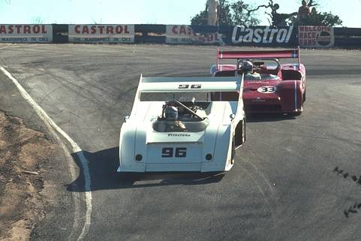

Why Region-Based Segmentation?
Segmentation
  Edge detection and Thresholding not always effective.
Homogenous regions
  Region-based segmentation.
  Effective in noisy images.
VC 14/15 - TP9 - Region-Based Segmentation

Slide 3
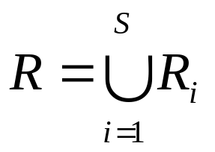

Definitions
Based on sets.
Each image R is a set of regions R_{i}.
  Every pixel belongs to one region.
  One pixel can only belong to a single region.
R₇
R₆
R₁
R₅
R₂
R₃
R₄
VC 14/15 - TP9 - Region-Based Segmentation

Slide 4
R₇
R₆
R₁
R₅
R₂
R₃
R₄
VC 14/15 - TP9 - Region-Based Segmentation

Slide 5
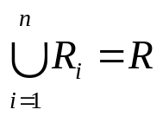



Basic Formulation
Let R represent the entire image region. Segmentation partitions R into n subregions, R₁, R₂, ..., R_{n}, such that:
a)
b)
c)
d)
e)
Every pixel must be in a region
Points in a region must be connected.
Regions must be disjoint.
All pixels in a region satisfy specific properties.
Different regions have different properties.
VC 14/15 - TP9 - Region-Based Segmentation

Slide 6
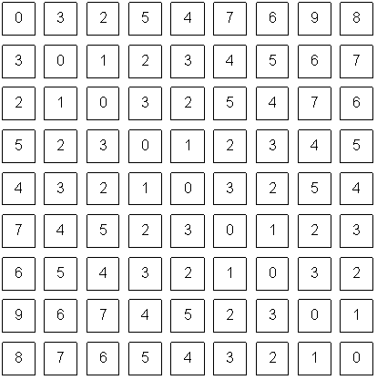
How do we form regions?
Region Growing
Region Merging
Region Splitting
Split and Merge
Watershed
...
What a computer sees
VC 14/15 - TP9 - Region-Based Segmentation

Slide 7
Region growing
Groups pixels into larger regions.
Starts with a seed region.
Grows region by merging neighboring pixels.
Iterative process
  How to start?
  How to iterate?
  When to stop?
Finish
Initial
Regions
Iterations
Stop
Condition
VC 14/15 - TP9 - Region-Based Segmentation

Slide 8
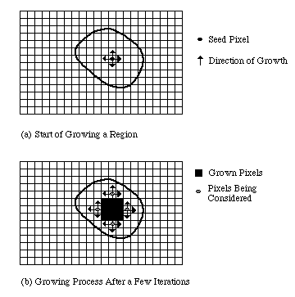
VC 14/15 - TP9 - Region-Based Segmentation

Slide 9
Region merging
Algorithm
  Divide image into an initial set of regions.
    One region per pixel.
  Define a similarity criteria for merging regions.
  Merge similar regions.
  Repeat previous step until no more merge operations are possible.
VC 14/15 - TP9 - Region-Based Segmentation

Slide 10
Similarity Criteria
Homogeneity of regions is used as the main segmentation criterion in region growing.
  gray level
  color, texture
  shape
  model
  etc.
Choice of criteria affects segmentation results dramatically!
VC 14/15 - TP9 - Region-Based Segmentation

Slide 11
Gray-Level Criteria
Comparing to Original Seed Pixel
  Very sensitive to choice of seed point.
Comparing to Neighbor in Region
  Allows gradual changes in the region.
  Can cause significant drift.
Comparing to Region Statistics
  Acts as a drift dampener.
Other possibilities!
VC 14/15 - TP9 - Region-Based Segmentation

Slide 12
Region splitting
Algorithm
  One initial set that includes the whole image.
  Similarity criteria.
  Iteratively split regions into sub-regions.
  Stop when no more splittings are possible.
R₁
R₁
R₂
R₃
R₄
R₁
R₂
R₁
R₂
R₃
R₃
R₄
R₅
R₄
R₅
R₆
R₇
R₆
R₇
VC 14/15 - TP9 - Region-Based Segmentation

Slide 13
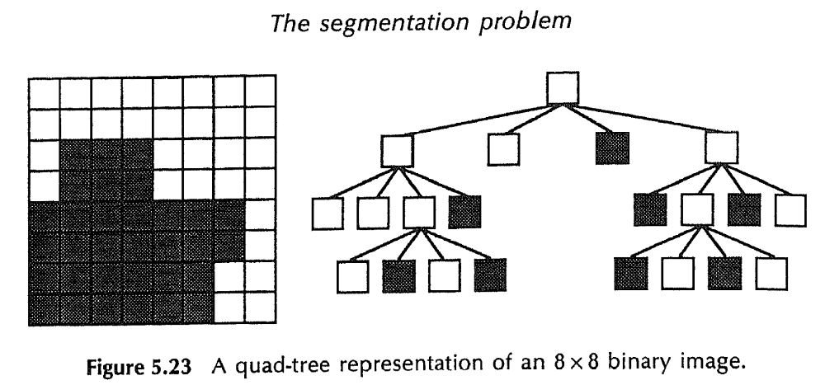
VC 14/15 - TP9 - Region-Based Segmentation
[Machine Vision; David Vernon]

Slide 14
Split and Merge
Combination of both algorithms.
Can handle a larger variety of shapes.
  Simply apply previous algorithms consecutively.
VC 14/15 - TP9 - Region-Based Segmentation

Slide 15
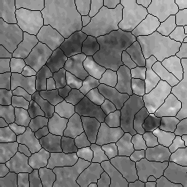
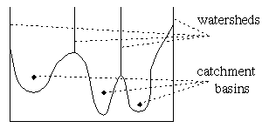
The Watershed Transform
Geographical inspiration.
  Shed water over rugged terrain.
  Each lake corresponds to a region.
Characteristics
  Computationally complex.
  Great flexibility in segmentation.
  Risk of over-segmentation.
VC 14/15 - TP9 - Region-Based Segmentation

Slide 16
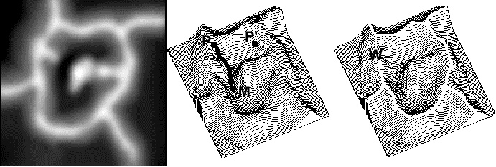
The Drainage Analogy
Two points are in the same region if they drain to the same point.
Courtesy of Dr. Peter Yim at National Institutes of Health, Bethesda, MD
VC 14/15 - TP9 - Region-Based Segmentation

Slide 17
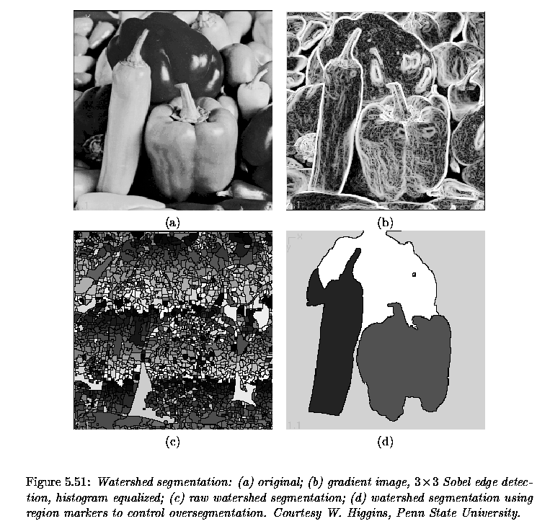
[Milan Sonka, Vaclav Hlavac, and Roger Boyle]
VC 14/15 - TP9 - Region-Based Segmentation

